Slide 1
Bankruptcy Prevention
🏦
Machine Learning Classification & Streamlit Deployment
250
Original Records
103
Unique Records
6
Risk Features
1

Slide 2
1. Problem Definition
Business objective and ML formulation
Identify whether a company belongs to the bankruptcy or non-bankruptcy class.
Use six business-risk indicators as predictive inputs.
ML task: supervised binary classification.
Target variable: class — bankruptcy = 1, non-bankruptcy = 0.
Objective: provide an early-risk prediction interface for analysis.
2

Slide 3
2. Dataset & Data Understanding
Six predictors and one target variable
Industrial Risk
Input Feature
Management Risk
Input Feature
Financial Flexibility
Input Feature
Credibility
Input Feature
Competitiveness
Input Feature
Operating Risk
Input Feature
Original records: 250
Exact duplicate rows detected: 147
Final records after duplicate removal: 103
Risk values are represented using 0, 0.5 and 1.
3

Slide 4
3. Data Preprocessing & EDA
Cleaning, validation and exploratory analysis
Checked structure, data types and descriptive statistics.
Checked missing values and feature values.
Removed exact duplicate rows before model training.
Inspected outliers; predefined risk scores were retained as valid values.
Analyzed target distribution and feature relationships.
Encoded target: bankruptcy = 1, non-bankruptcy = 0.
4

Slide 5
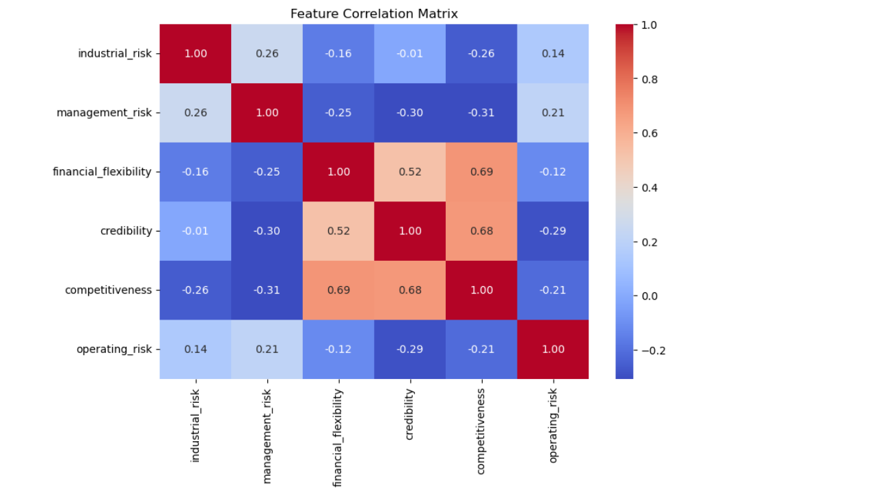

Slide 6
4. Machine Learning Workflow
From cleaned data to deployed application
Clean Data
Encode Target
80/20 Stratified Split
Scale Features
Train 4 Models
Evaluate
Streamlit
Logistic Regression and KNN use StandardScaler through a Pipeline.
Decision Tree and Random Forest use the risk-score features directly.
Train/test split uses test_size=0.20, random_state=42 and stratify=y.
5

Slide 7
5. Classification Models
Four algorithms implemented individually
Logistic Regression
Linear baseline + StandardScaler
KNN
Distance-based + StandardScaler
Decision Tree
Interpretable tree; max_depth=4
Random Forest
200 trees; max_depth=5
6

Slide 8
6. Model Evaluation & Comparison
Results from the uploaded application configuration
Model | Accuracy | Precision | Recall | F1 Score
Logistic Regression | 95.24% | 100.00% | 80.00% | 88.89%
KNN | 95.24% | 100.00% | 80.00% | 88.89%
Decision Tree | 95.24% | 100.00% | 80.00% | 88.89%
Random Forest | 95.24% | 100.00% | 80.00% | 88.89%
Best test accuracy on this split: Logistic Regression (95.24%).
Bankruptcy recall is especially important because false negatives can be costly.
The cleaned dataset is small, so performance should be interpreted cautiously.
7

Slide 9
7. Feature Importance & Insights
Random Forest interpretation
Competitiveness
0.571
Financial Flexibility
0.179
Credibility
0.175
Industrial Risk
0.031
Operating Risk
0.029
Management Risk
0.014
Highest importance in this run: Competitiveness.
Feature importance indicates predictive contribution, not causation.
Insights should support further business investigation.
8

Slide 10
8. Streamlit Application
Interactive prediction and model evaluation interface
Home: project overview, dataset statistics and target distribution.
Prediction: select one of four models and enter six risk scores.
Output: Bankruptcy / Non-Bankruptcy and probabilities when available.
Model Performance: accuracy, classification reports and confusion matrices.
Dataset Analysis: cleaned data, statistics and Random Forest feature importance.
Prediction
Interactive model input
Performance
Metrics + confusion matrices
Analysis
Data + feature importance
9

Slide 11
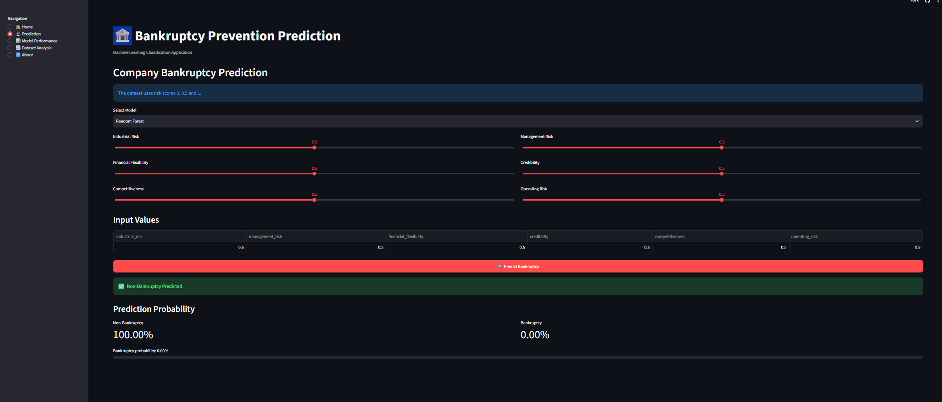

Slide 12
9. Conclusion & Future Scope
Project outcome
Built an end-to-end bankruptcy classification workflow from preprocessing to deployment.
Compared four classification algorithms using common evaluation metrics.
Developed an interactive Streamlit application for prediction and model analysis.
Demonstrated practical skills in Python, Pandas, Scikit-learn, visualization and deployment.
Future scope: collect more real-world data, strengthen cross-validation/tuning, monitor bankruptcy recall, calibrate probabilities and add model monitoring.
10

